Slide 1

7.

Slide 2
Agenda
History
Mobile app testing strategy
Device selection
Delivery
Mobile apps types
Mobile testing guide
Application activity lifecycle
Mobile UX guideline
Tools
Notes:
Тестирование методом свободного поиска, Экспериментальное тестирование (exploratory testing)

Slide 3
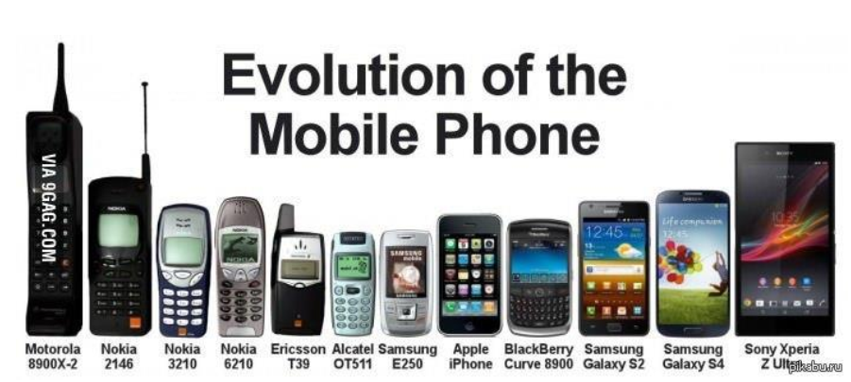
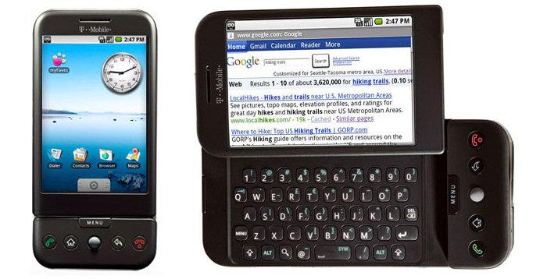
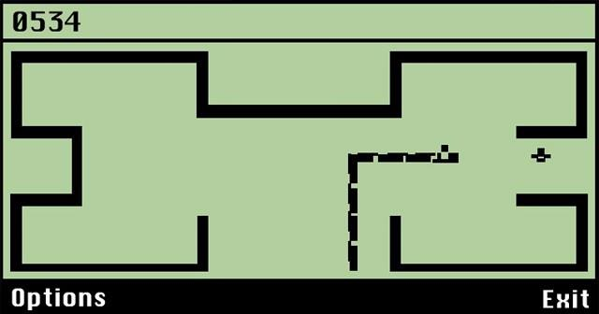
Mobile apps, development
• Phone main goal – to make calls • First apps – contact book • Personal Digital Assistant (PDA) devices • Mobile become replacement for Computers

Slide 4

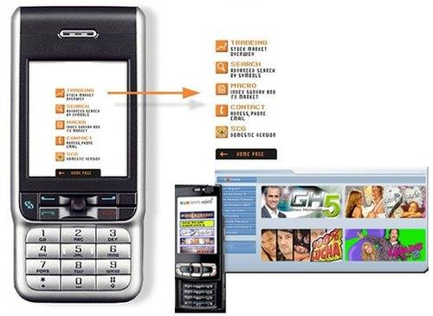

Mobile Apps, growing
• First mobile protocol – WAP • Internet Marketing • App Markets • Extremely growing market

Slide 5
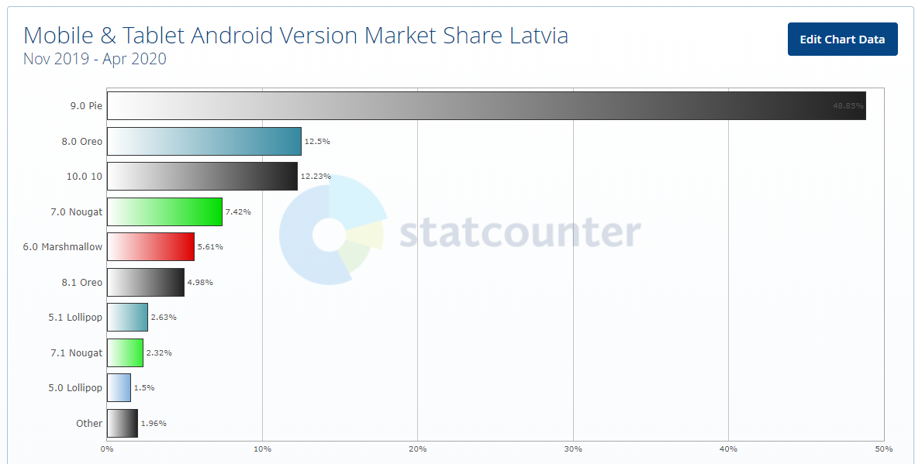
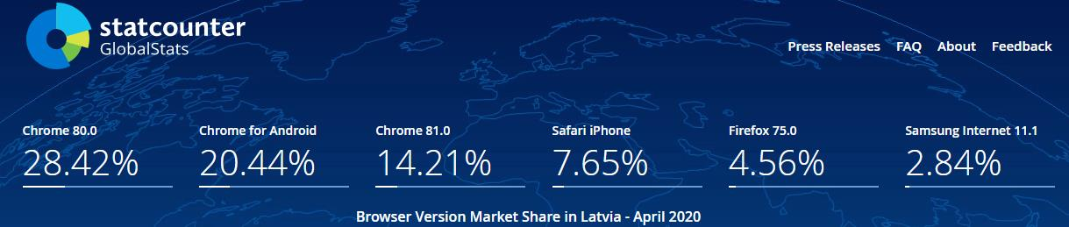
Mobile Apps,
actual market

Slide 6
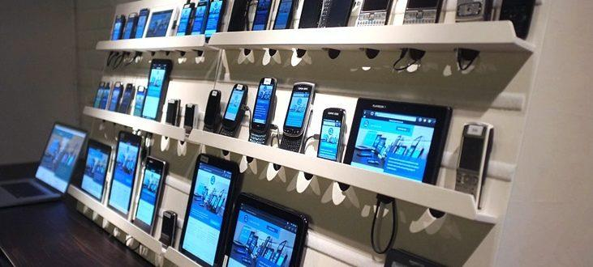
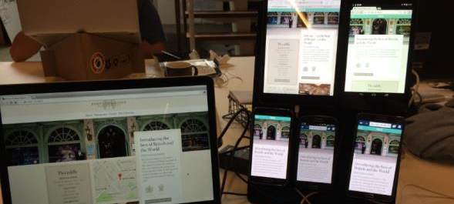
Mobile device selection
How to choose test devices: •Market shares, Popularity •Client Statistics, Requirements •Available devices on local market •Available company devices •Personal devices •Emulators •Device farms

Slide 7
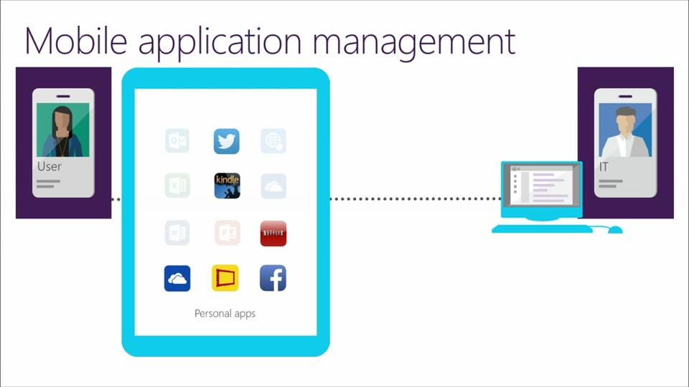
MAM – mobile delivery
Delivery on test devices TestFlight, HockeyApp, Fabric by Twitter, Beta by Crashlytics, and TestFairy are the most popular tools in the category "Beta Testing / Mobile App Distribution".
"Must have for iOS development" is the primary reason developers pick TestFlight over its competitors, while "Crash analytics" is the reason why HockeyApp was chosen.

Slide 8
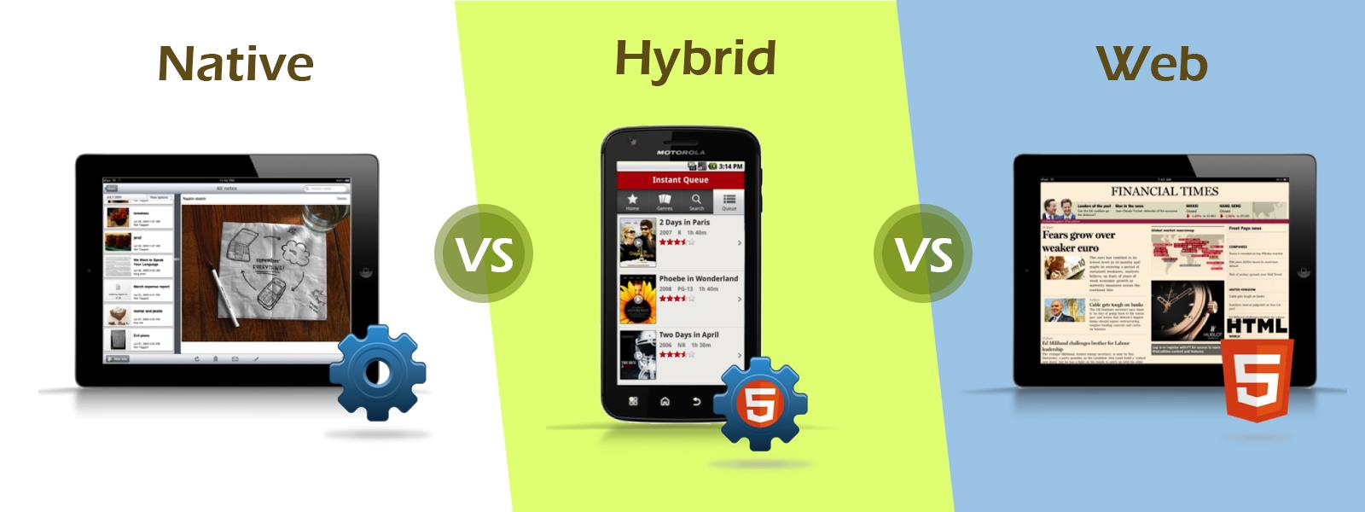
Types of mobile apps

Slide 9


Web app
Mobile Web application, in fact, is the website opened in the gadget (smartphone or tablet) with the help of the mobile browser.
- Easy development - Easy access - Easy update - Mobile Web App requires no installation
- No offline capabilities support. - Limited functionality in the comparison with Hybrid and Native Apps. (no access to the file system and local resources).

Slide 10
Native app
Native App is the application, which has been developed specifically for one platform (Android, iOS, Windows 10, BlackBerry).
- Works offline - Can use all features of its device - Advanced user experience - Push notifications can be used for users alert
- Creation is expensive in comparison to the Mobile Web apps - Requires high costs for the maintenance

Slide 11
Hybrid app
Hybrid App is the mix of the Native App and Mobile Web App. It can be defined like mobile website content exposition in the application format.
- More cost effective in comparison to the Native App - Easy distribution - Embedded browser - Device features
- Works not so fast as Native App. - Graphics are less accustomed to the OS in comparison to Native App .

Slide 12
• Common aspects (platforms, devices, orientation, pixel perfect, external modules, target) • Analysis by app pages (requests, timers, cache, refresh) • Controls (SF, HW) • Permissions • Lists, Pagination (lazy loading, filters, sorting) • Social Networks interaction • Device specific, Interruptions (on/off/lock, call, alarm, flightmode, bluetooth) • Notifications
Mobile Testing Guide

Slide 13
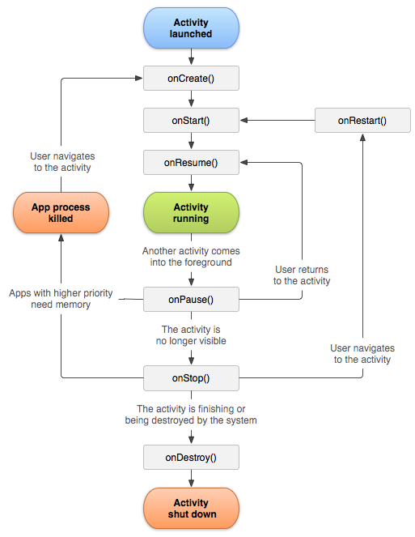
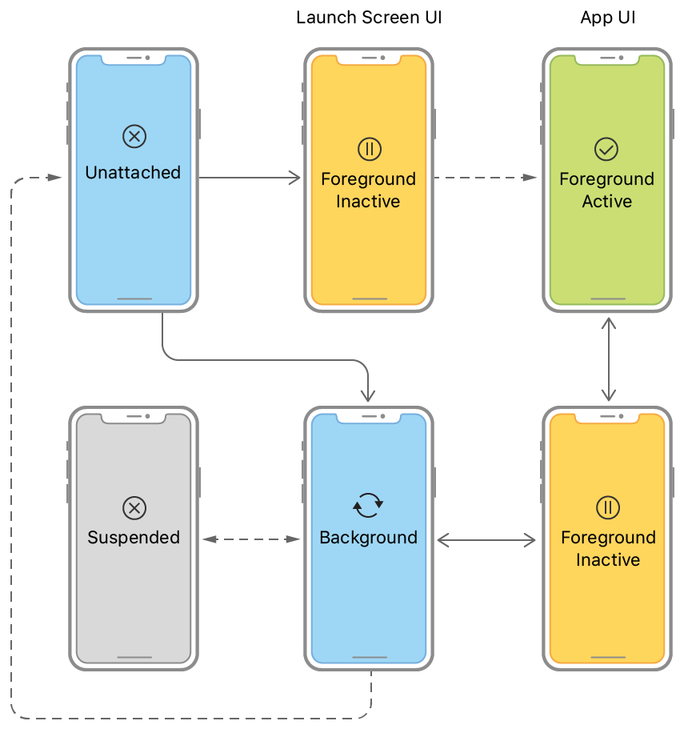
Application Activity Lifecycle

Slide 14
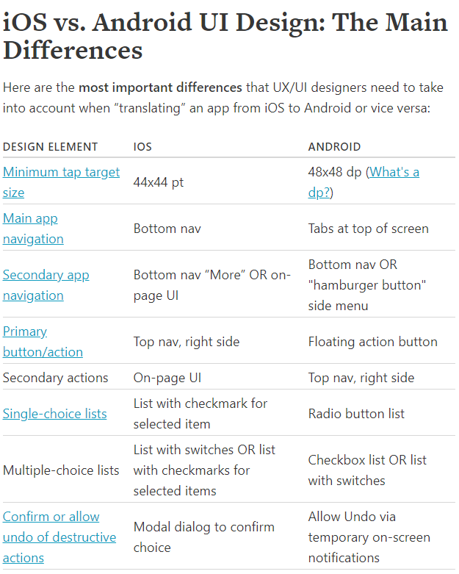
Mobile UI/UX guidelines

Slide 15
Mobile testing Tools
• Charles • Wireshark • Fiddler • Browser DevTools Emulator • ADBa • IDE • Simulators or Emulators • Cloud based Farms

Slide 16
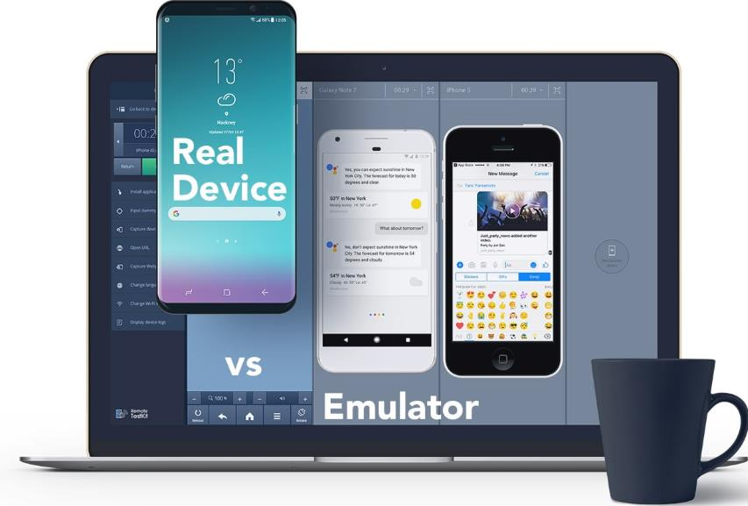
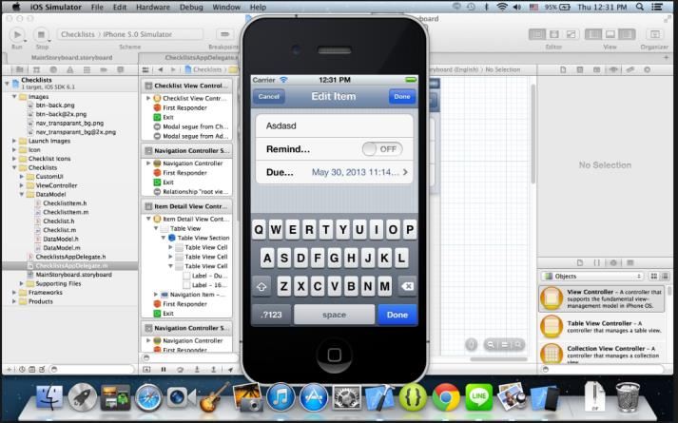
Emulators and Simulators
Emulators/simulators are special tools, which emulate/simulate functionality and behavior of mobile devices
Emulator is the original device replacement. Though you can run soft and apps on your gadget, you have no ability to modify them. Emulators are more appropriate for the mobile site testing.
Simulator doesn't replicate device's hardware, but you have an ability to set up the similar environment as the original device’s OS. So, it is better to use mobile simulators to test mobile application.

Slide 17

Cloud-based testing of mobile app
Main advantages of this approach: + Easy availability. + An ability to run mobile devices on multiple systems and networks. + An ability not only to test, but also update and manage apps in the cloud. + Cost effective. + High scalability. + The same script can be run on several devices in parallel.
Some weak points: - Less of the control. - No so high level of the security. - Dependence of the Internet connection.

Slide 18
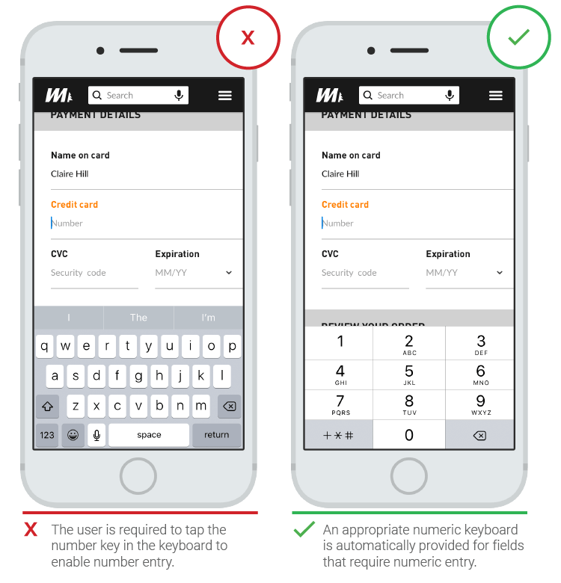
Bugs in mobile apps: example

Slide 19
HomeWork 7
Пpотестировать мобильное приложение Wase для любой из платформ - IOS\Android, используя чеклист, приведенный ниже. Составьте на основе данного общего чеклиста, список проверок для приложения навигатора - Wase для любой из мобильных операционных систем(Android or IOS) и любого девайса (можно использовать ваш личный девайс). Главная задача понять специфику мобильных приложений, и научиться понимать особенности платформы и работать с основными функциями девайса и операционной системы.
1. Составить чеклист 2. Пройти по чеклисту и проставить статусы pass\fail\blocked 3. В случае статуса fail - надо завести баги в джиру и написать в табличку 4. В случае blocked надо написать комментарий почему прохождение проверки заблокировано. 5. Результатом работы должен быть тест репорт в джире с статусами и всеми заведенными багами.
Учтите, что работа будет в одном проекте, командная. Смотрите какие баги уже были заведены, заводить одинаковые баги не стоит. Дополняйте, перепроверяйте существующие баги на разных платформах.

